Slide 1
Module 2
Encoding techniques

Slide 2
DIGITAL-TO-DIGITAL CONVERSION
In this section, we see how we can represent digital data by using digital signals. The conversion involves three techniques: line coding, block coding, and scrambling. Line coding is always needed; block coding and scrambling may or may not be needed.
Topics discussed in this section:
Line Coding
Line Coding Schemes Block Coding
Scrambling

Slide 3
DIGITAL-TO-DIGITAL CONVERSION
Line Coding:
Converts sequence of bits to digital signal
Signal decode at the receiver end to get the original data

Slide 4
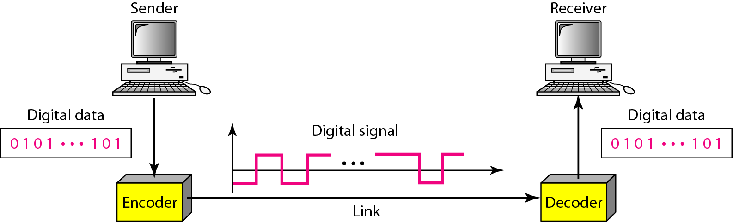
Figure 4.1 Line coding and decoding

Slide 5
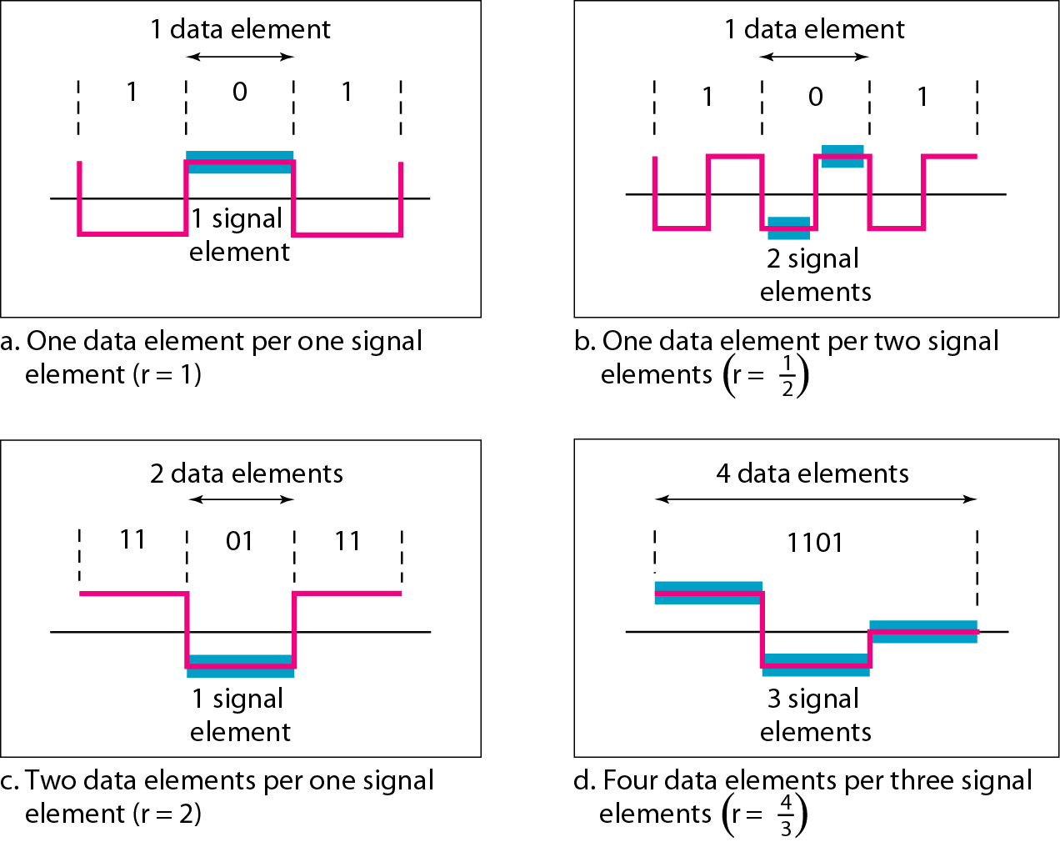
Figure 4.2 Signal element versus data element
Ratio r

Slide 6
Data rate Vs Signal rate

Slide 7
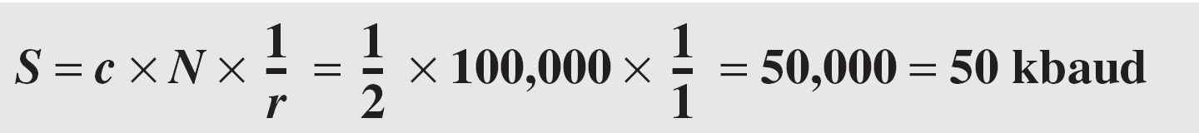
Example 4.1
A signal is carrying data in which one data element is encoded as one signal element ( r = 1). If the bit rate is 100 kbps, what is the average value of the baud rate if c is between 0 and 1?
Solution
We assume that the average value of c is 1/2 . The baud rate is then

Slide 8

Note
Although the actual bandwidth of a digital signal is infinite, the effective bandwidth is finite.

Slide 9
Example 4.2
The maximum data rate of a channel (module 1) is N_{max} = 2 × B × log₂ L (defined by the Nyquist formula). Does this agree with the previous formula for N_{max}?
Solution
A signal with L levels actually can carry log₂L bits per level. If each level corresponds to one signal element and we assume the average case (c = 1/2), then we have

Slide 10
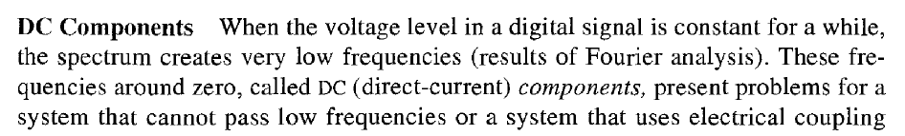

Slide 11
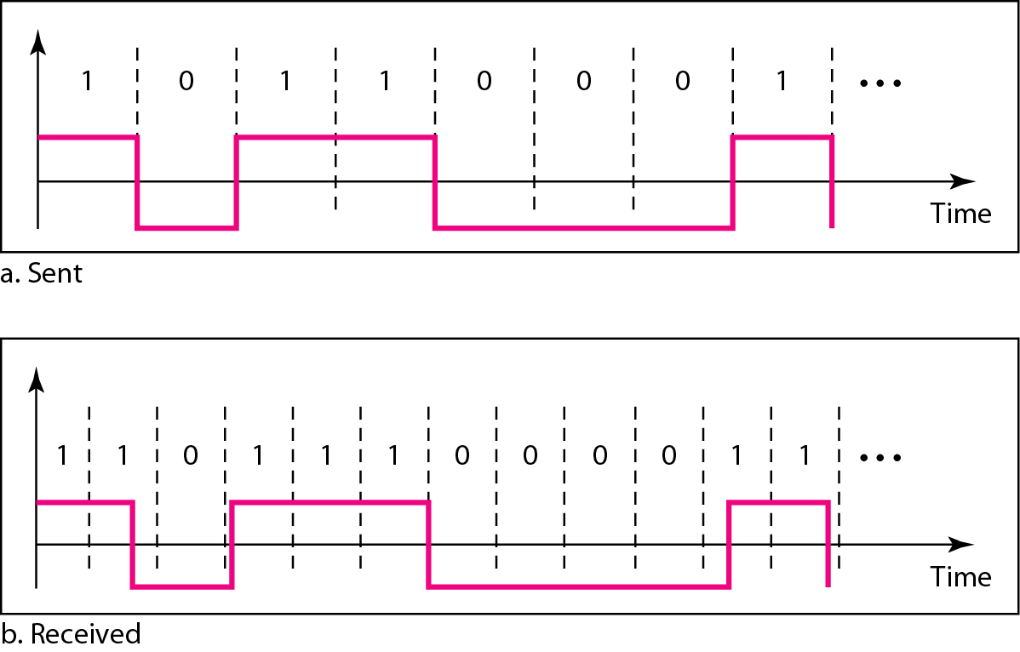
Figure 4.3 Effect of lack of synchronization

Slide 12
Example 4.3
In a digital transmission, the receiver clock is 0.1 percent faster than the sender clock. How many extra bits per second does the receiver receive if the data rate is 1 kbps? How many if the data rate is 1 Mbps?
Solution
At 1 kbps, the receiver receives 1001 bps instead of 1000 bps.
At 1 Mbps, the receiver receives 1,001,000 bps instead of 1,000,000 bps.

Slide 13
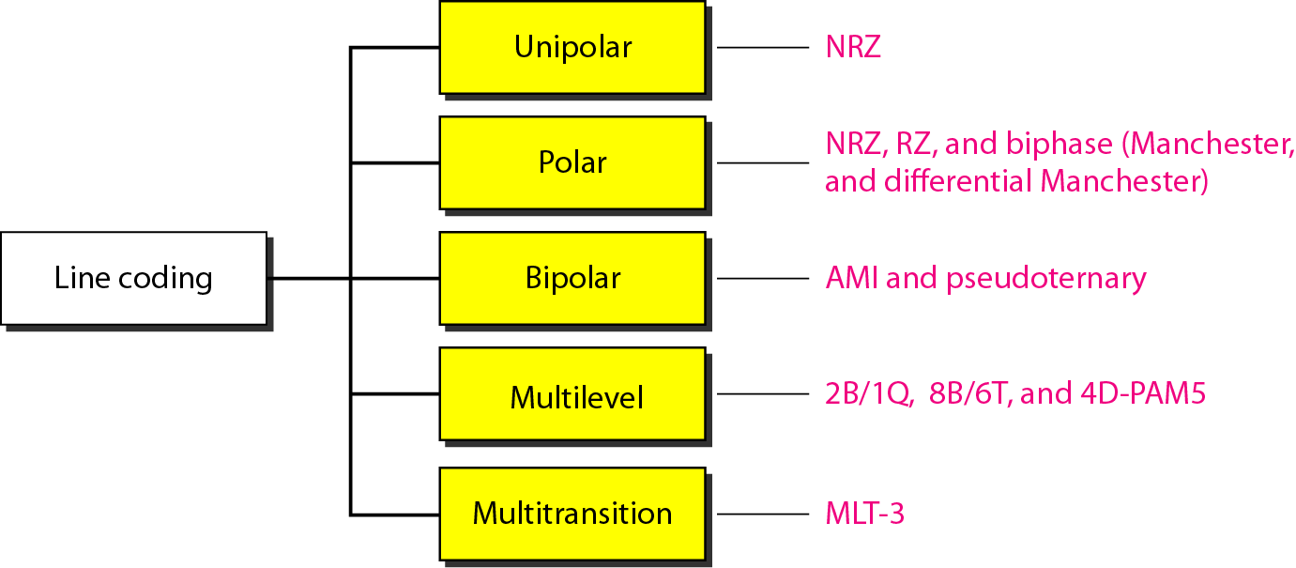
Figure 4.4 Line coding schemes

Slide 15
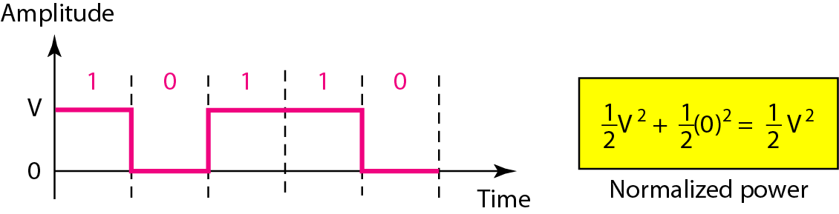
Figure 4.5 Unipolar NRZ scheme
Power needed to send 1 bit per unit line resistance

Slide 16
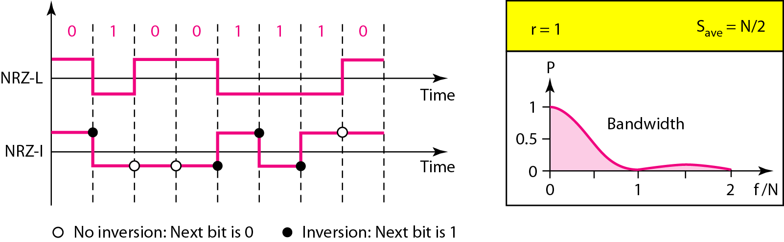
Figure 4.6 Polar NRZ-L(Level) and NRZ-I(invert) schemes

Slide 17
Note
In NRZ-L the level of the voltage determines the value of the bit. In NRZ-I the inversion or the lack of inversion determines the value of the bit.

Slide 18
Note
NRZ-L and NRZ-I both have an average signal rate of N/2 Bd.

Slide 19
Note
NRZ-L and NRZ-I both have a DC component problem.

Slide 20
Example 4.4
A system is using NRZ-I to transfer 10-Mbps data. What are the average signal rate and minimum bandwidth?
Solution
The average signal rate is S = N/2 = 500 kbaud. The minimum bandwidth for this average baud rate is B_{min} = S = 500 kHz.

Slide 21
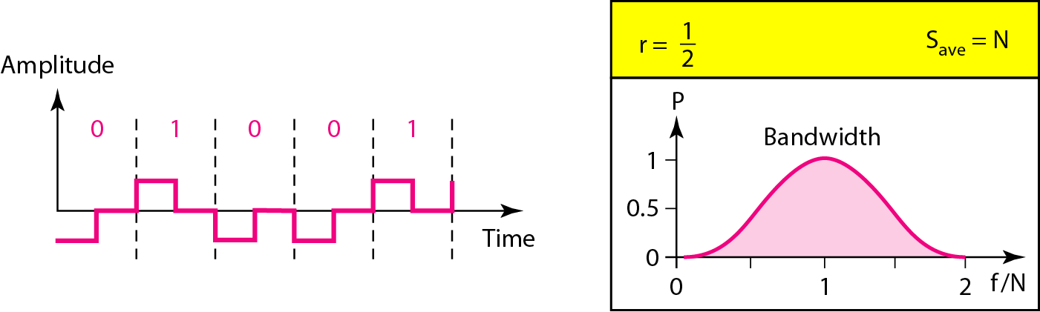
Figure 4.7 Polar RZ scheme
Complex and uses greater bandwidth

Slide 22
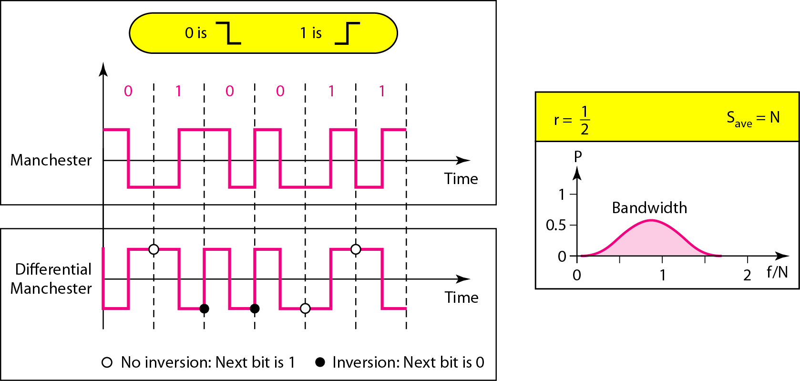
Figure 4.8 Polar biphase: Manchester and differential Manchester schemes

Slide 23
Note
In Manchester and differential Manchester encoding, the transition
at the middle of the bit is used for synchronization.

Slide 24
Note
The minimum bandwidth of Manchester and differential Manchester is 2 times that of NRZ.

Slide 25
Note
In bipolar encoding, we use three levels: positive, zero, and negative.

Slide 26
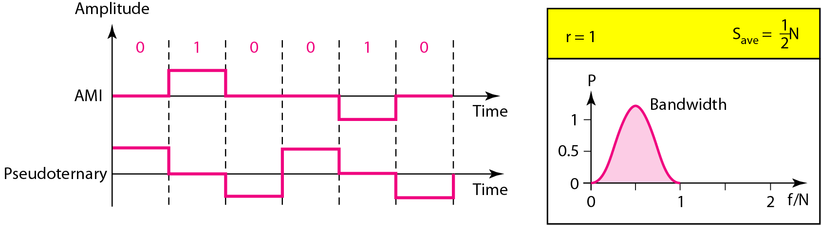
Figure 4.9 Bipolar schemes: AMI and pseudoternary

Slide 27
Note
In mBnL schemes, a pattern of m data elements is encoded as a pattern of n signal elements in which 2^{m} ≤ L^{n}.

Slide 28
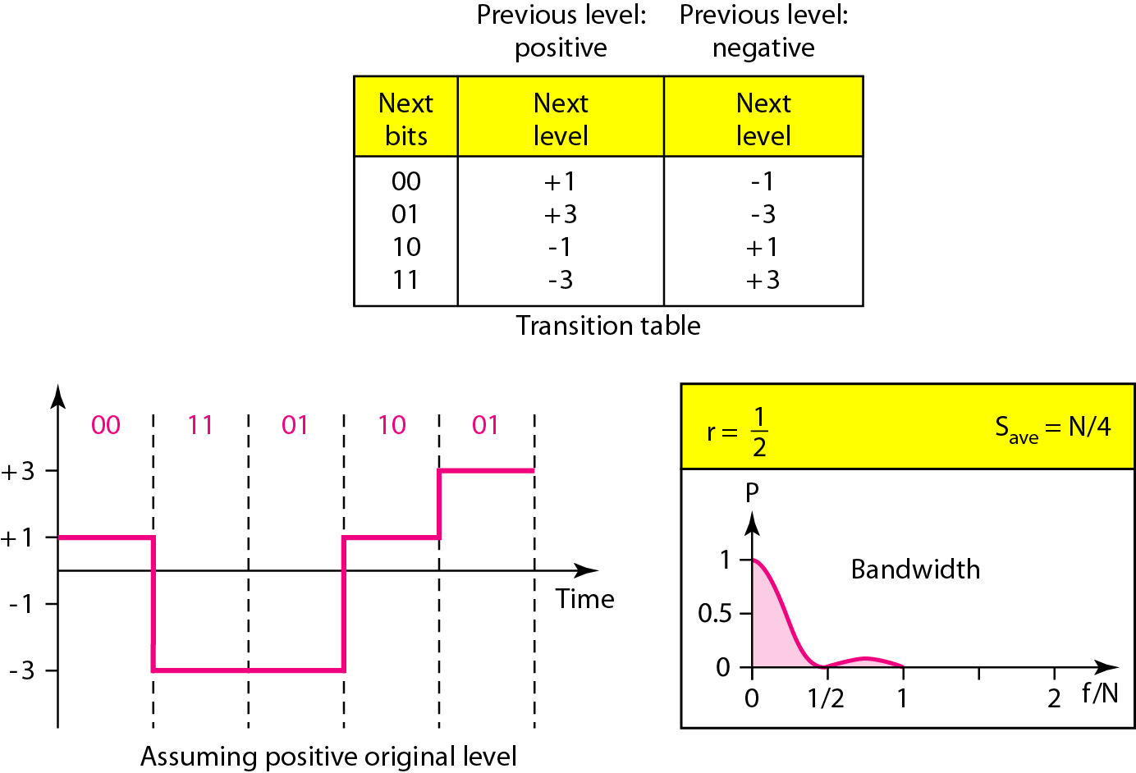
Figure 4.10 Multilevel: 2B1Q scheme

Slide 29
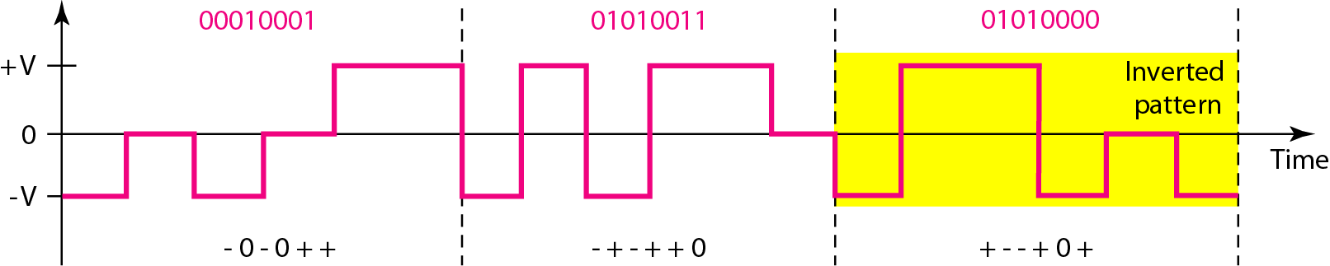
Figure 4.11 Multilevel: 8B6T scheme(homework)

Slide 31
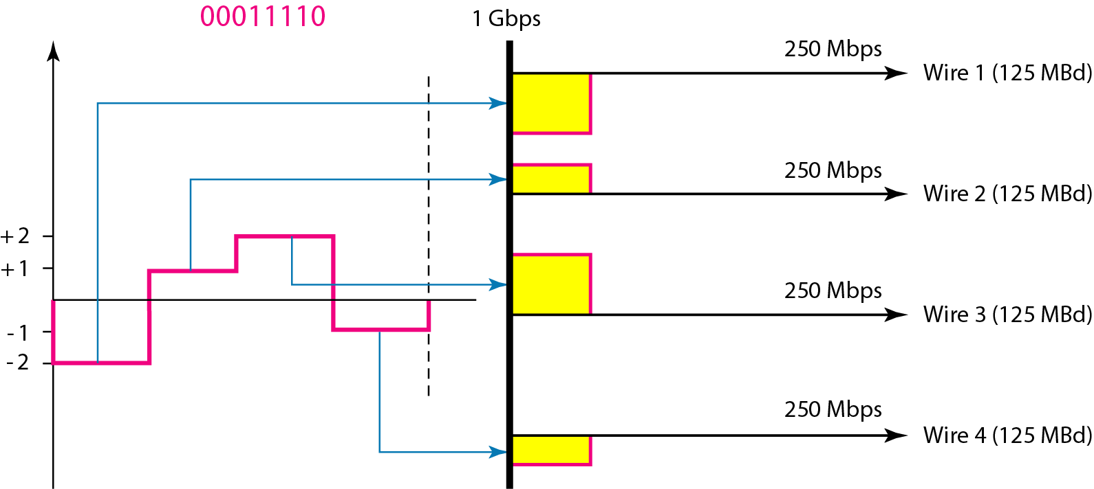
Figure 4.12 Multilevel: 4D-PAM5 scheme

Slide 32
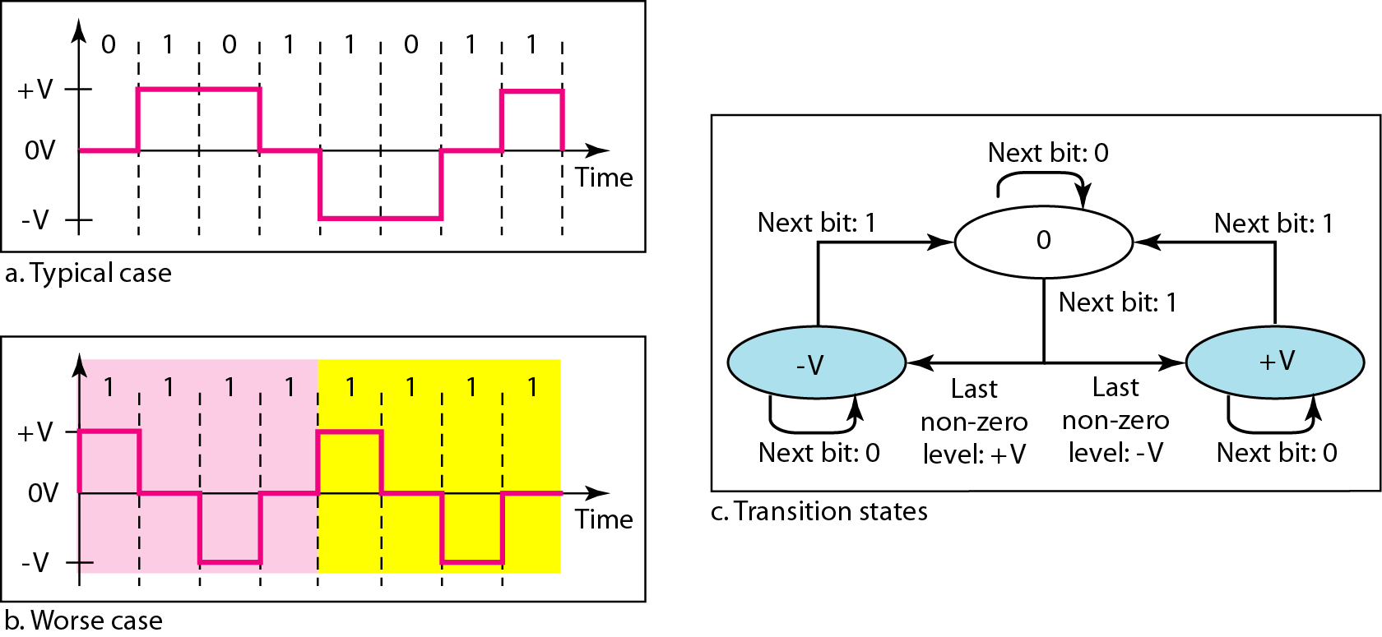
Figure 4.13 Multitransition: MLT-3 scheme

Slide 33
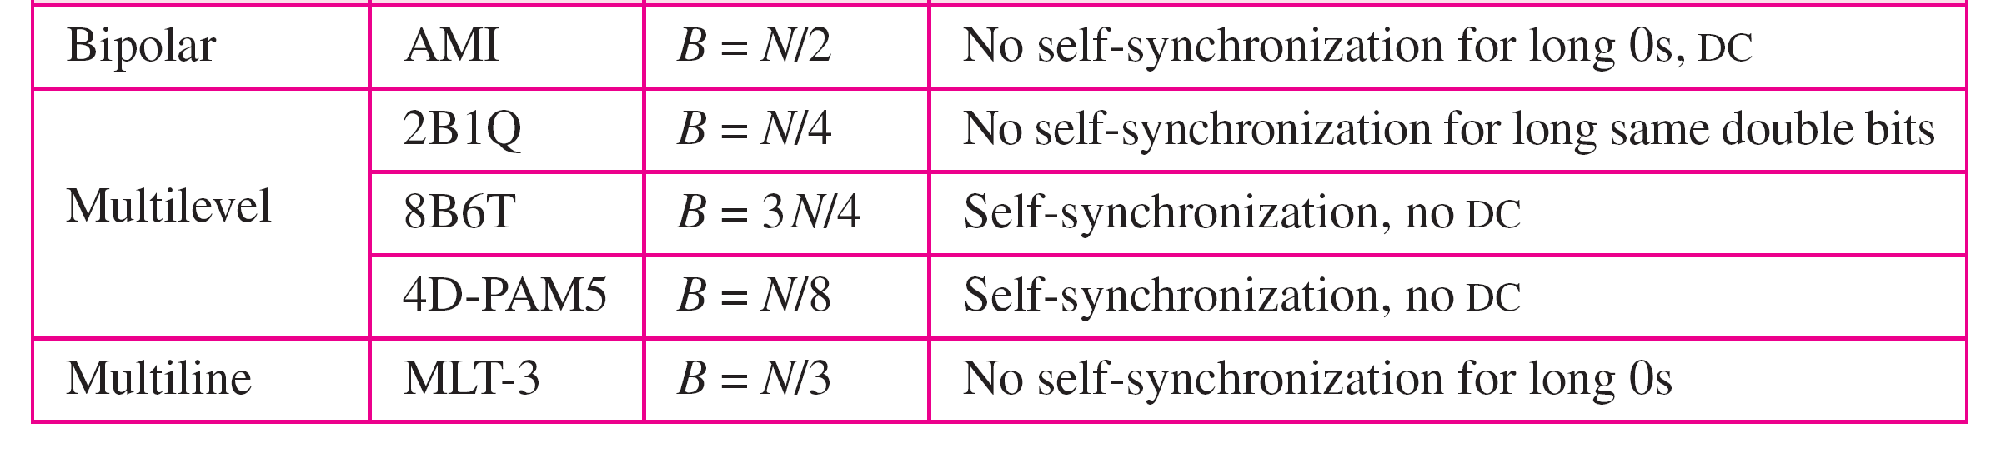
Table 4.1 Summary of line coding schemes

Slide 34

References::
Chapter 4
Digital Transmission
Copyright © The McGraw-Hill Companies, Inc. Permission required for reproduction or display.

